Slide 1
Characteristics of Big Data
Volume refers to vast amounts of data that is generated.
Velocity refers to the speed at which data is being generated and moves from one point to the next
Variety refers to the ever increasing different data formats (i.e Text, Video, Image, Voice, Geospatial)
Veracity refers to unmeasurable uncertainties and truthfulness and trustworthiness of data
Valence refers to the connectedness of big data in the form of graphs
Value

Slide 2
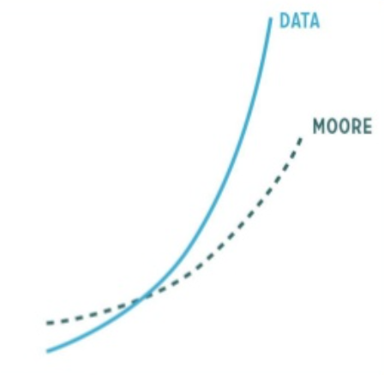
Big Data: Double Edged Sword
Houston, we have a problem!
IDC says Digital Universe will be 35 Zettabytes by 2020.
1 Zettabyte = 1,000,000,000,000,000,000,000 bytes or 1 billion terrabytes
1 Yottabyte = 10²⁴ bytes
1000 MB = 1 GB
1000 GB = 1 TB
1000 TB = 1 PB
Data Volume vs. Moore’s Law
“Data is the new gold”
(Open Data Initiative, European Commission. aim at opening up Public Sector Information)

Slide 3
HDD Technology and Advantage of Parallelism
HDD size is improving faster than the transfer rate
Typically in 90’s a drive would be of 1GB HDD and transfer speed would be 4.5 MB/s
Time taken to read the drive = total disk / speed = 1000/4.5 ~ 222 sec. ~ 4 mins
Typical scenarios nowadays is 1TB disk and transfer speed of 100MB/s
Time takes to read the drive = 1,000,000/100 ~ 10,000 Sec. ~ 166 mins = 2.8hrs
Suppose that the 1TB data is distributed over 50 nodes on a cluster with 1/50th of the data on each node then Read time will be 166 mins / 50 which is close to ~ 3.5 min

Slide 4
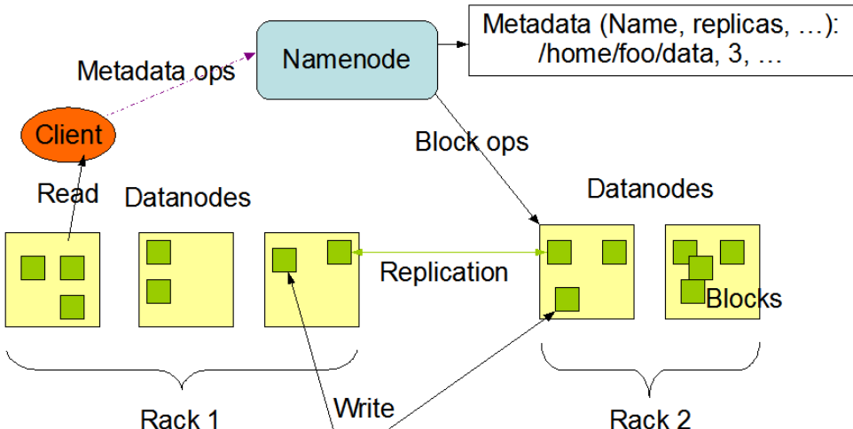
HDFS Structure
Two key components of HDFS
1) NameNode for metadata – Meta data (Usually One per cluster)
Coordinates operations
Keeps track of file name, location in directory, etc.
2) DataNode for block storage (Usually One per server)
DataNode stores file blocks
Listens to NameNode for block creation, deletion, replication

Slide 5
Hadoop Structure
HDFS = Hadoop Distributed File System
YARN = Resource Manager for Hadoop
MapReduce = Programming Model
Pig = dataflow scripting (created at Yahoo)
Hive = SQL – like queries (created at Facebook)
Giraph = specialized models for graph processing
Spark, Storm, Flink = Real-time and in-memory processing
Zookeeper = for management

Slide 6
Question # 1
Amazon has been collecting review data for a particular product. They have realized that almost 90% of the reviews were mostly a 5/5 rating. However, of the 90%, they realized that 50% of them were customers who did not have proof of purchase or customers who did not post serious reviews about the product. Of the following, which is true about the review data collected in this situation?
High Volume
High Valence
High Veracity
Low Valence
Low Veracity
Low Volume

Slide 7
Question #2
As mentioned in the class, what are the challenges to data with a high valence?
Complex data exploration algorithms
Difficult integrate
Reliability of Data

Slide 8
Question #3
What is the veracity of big data?
The connectedness of data
The size of the data
The speed at which data is produced
The abnormality or uncertainties of data

Slide 9
Question #4
Which of the following are the 6 V's in big data?
Valence
Vision
Volume
Variety
Value
Velocity
Veracity

Slide 10
Question #5
What are the challenges of data with high variety?
The quality of data is low
Hard to perform emergent behavior analysis
Hard in utilizing group event detection
Hard to integrate

Slide 11
Question # 1
What are the two key components of HDFS and what are they used for?
NameNode for block storage and Data Node for metadata.
FASTA for genome sequence and Rasters for geospatial data.
NameNode for metadata and DataNode for block storage.

Slide 12
Question #2
What is the job of the NameNode?
Coordinate operations and assigns tasks to Data Nodes
Listens from DataNode for block creation, deletion, and replication.
For gene sequencing calculations.

Slide 13
Question #3
What is the order of the three steps to Map Reduce?
Shuffle and Sort -> Map -> Reduce
Map -> Reduce -> Shuffle and Sort
Map -> Shuffle and Sort -> Reduce
Shuffle and Sort -> Reduce -> Map

Slide 14
Question #4
What is the difference between low level interfaces and high level interfaces?
Low level deals with interactivity while high level deals with storage and scheduling
Low level deals with storage and scheduling while high level deals with interactivity

Slide 15
Question #5
Which of the following are problems to look out for when integrating your project with Hadoop?
Advanced Alogrithms
Task Level Parallelism
Data Level Parallelism
Random Data Access

Slide 16
Question #6
What is the purpose of YARN?
Allows various applications to run on the same Hadoop cluster.
Enables large scale data across clusters.
Implementation of Map Reduce.

